Slide 1
Code
395262

Slide 2
Lecture 10 Project3 and Other Stuff
Greg Lakomski
CS3339
Spring 2019

Slide 3
Today
Project 3 – Go over project in detail – at least part of it

Slide 4
Announcements

Slide 5
Introduction
The goal of this lecture is to make sure you see this project3 in the same way that I do.
In the interest of time and student happiness (if that is ever possible) I am going to tell you a lot more about Project 3 than I did for 2.
I will be sharing code but what is more important is the logic, algorithms and data structures as well as seeing how the problem is organized in code. You will be responsible for understanding any code I give you in detail

Slide 6
Introduction
Try to follow and then spend time figuring it out.
My goal of showing you my code is to help you all finish the project and make sure you don’t get stuck a lot.
You are free to disregard anything I am suggesting at your peril.

Slide 7
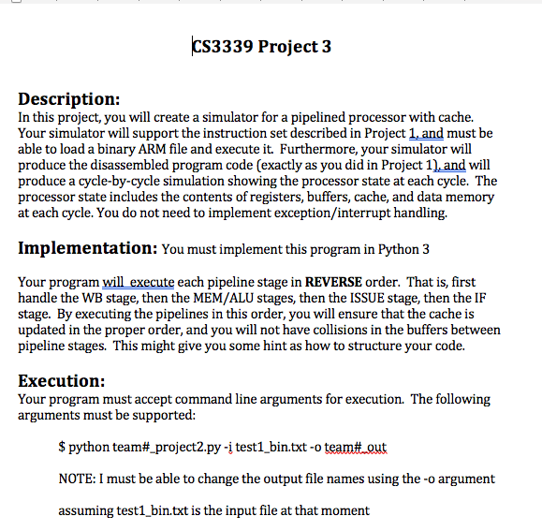

Slide 8
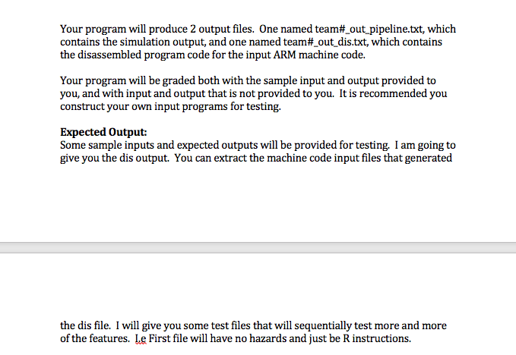

Slide 9
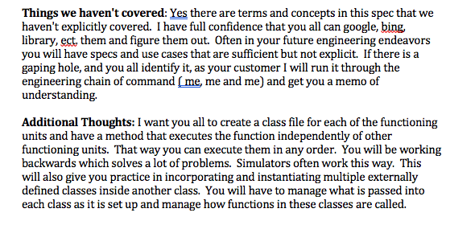

Slide 10
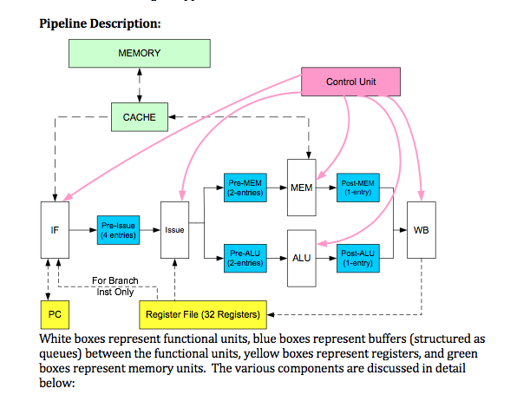

Slide 11
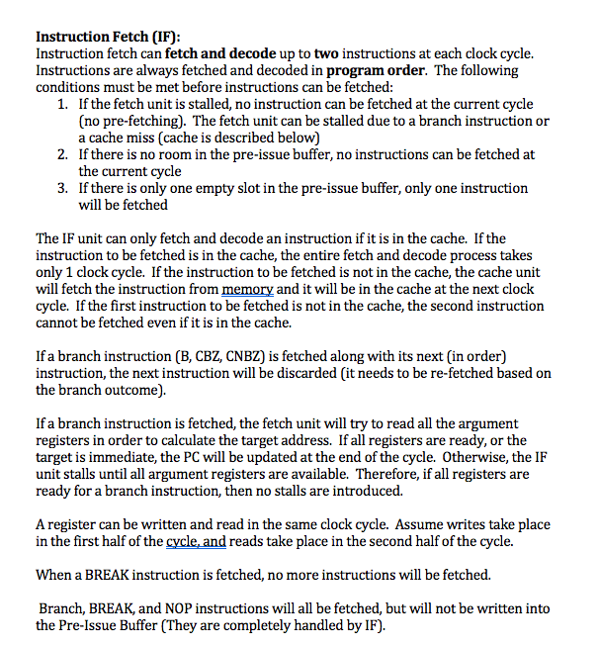

Slide 13


Slide 15
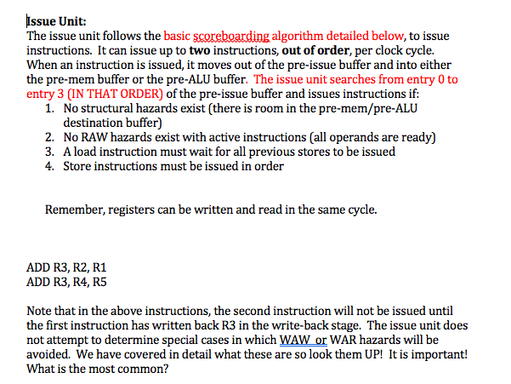

Slide 17
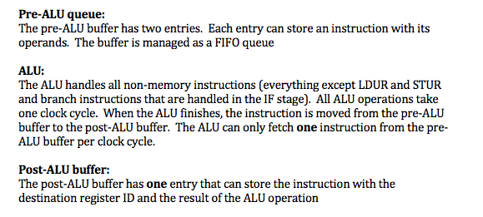

Slide 19
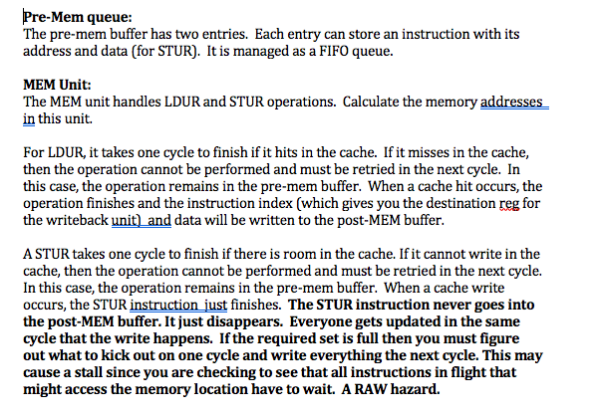

Slide 21
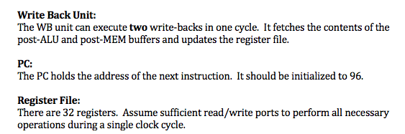

Slide 22
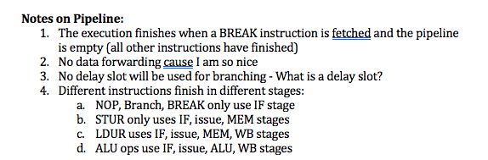

Slide 24
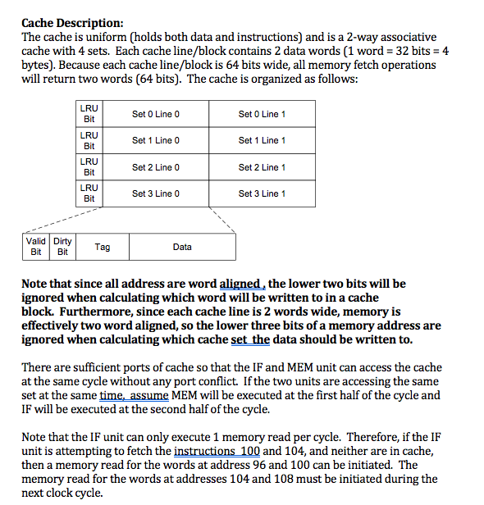

Slide 25
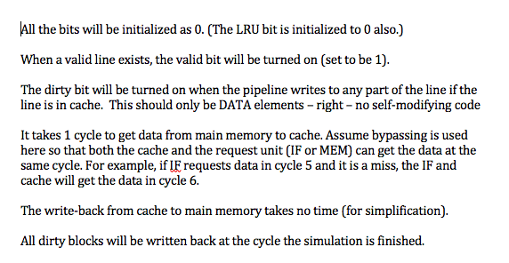

Slide 26
I have made a decision
I will give you my cache code rather than having you write your own
WHY?
It is quite complicated
There are other complicated sections of the simulator
This has been the big hang up in the past to completing the project.
I will cover the cache in a separate lecture
YOU WILL BE RESPONSIBLE FOR UNDERSTANDING IT

Slide 27
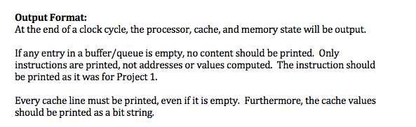

Slide 28
Output example
Lets look at example dis and pipeline output

Slide 29
About the code?

Slide 30
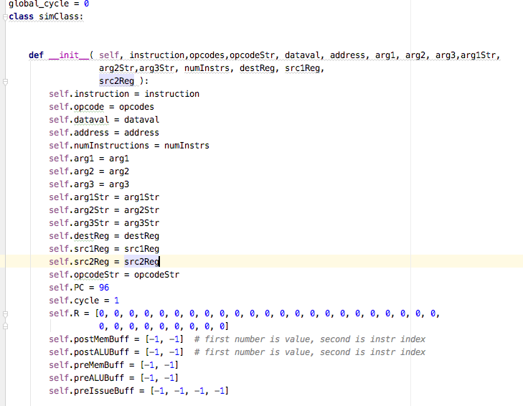

The new sim class
Warning: I am still modifying my own code so do NOT just copy this stuff
NEW You need to modify your disassembler

Slide 31
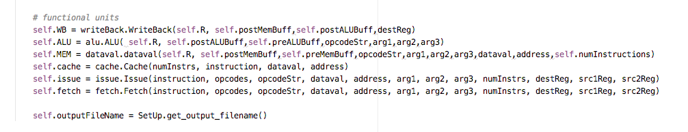
Instantiation of classes
Warning: I am still modifying my own code so do NOT just copy this stuff!!!!!
This is only partly finished !!!!!!!
Part of the init code

Slide 32
Input Lists
dest: (these are reg numbers)
<type 'list'>: [4, 5, 6, -10, -2, -6]
src1:
<type 'list'>: [0, 0, 4, 6, 0, -7]
src2:
<type 'list'>: [-1, -1, 5, -9, 6, -8]
NOTE: these are new. I found it necessary to catalog the actual register values by instruction. If there was no actual dest or src then I made it a negative number and test for the neg . The sequential numbers is good for debugging.

Slide 33
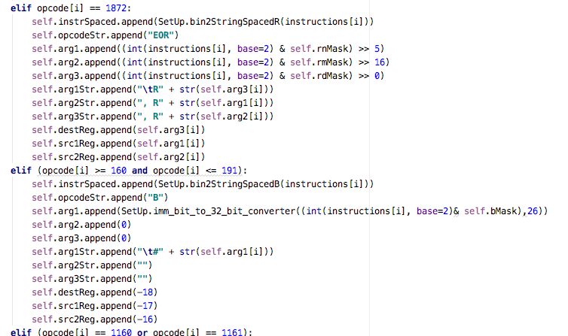


Example from disassembler
ALL REGISTERS USED
There are no source and destination
registers in the B instruction

Slide 34
Main sim execution flow
def run( self): go = True while go: self.WB.run() self.ALU.run() self.MEM.run() self.issue.run() go = self.fetch.run() self.printState( ) self.cycle += 1

Slide 35
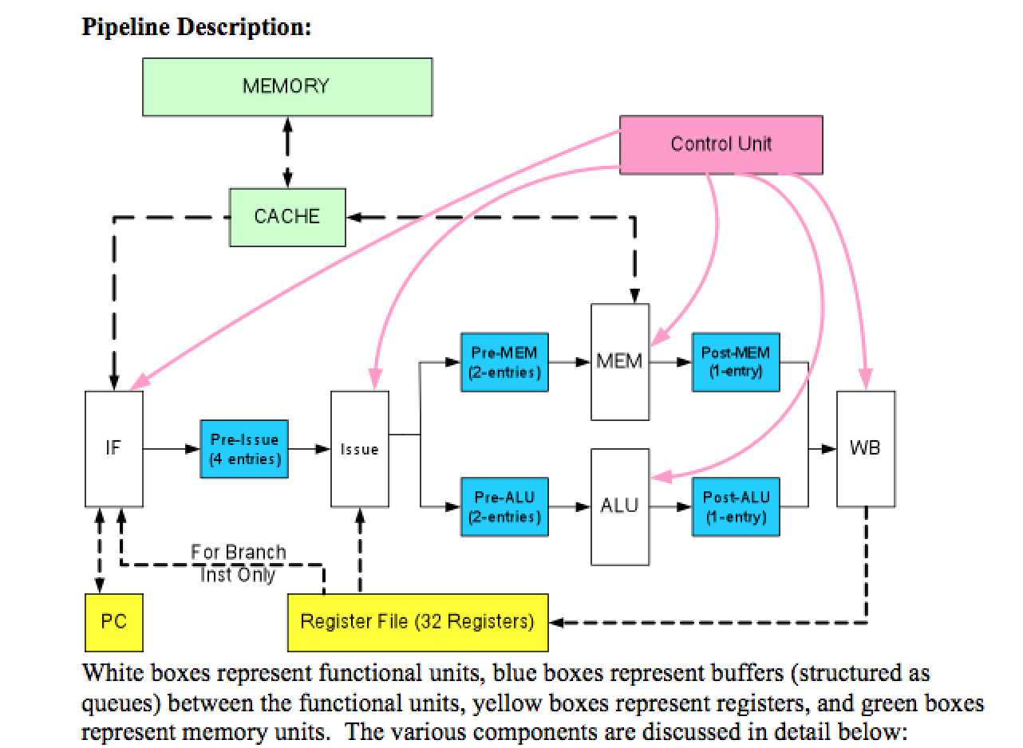
Pipeline

Slide 36
The Big Challenge
Each stage and unit may be executing a different instruction. SO how do we know which. We move the instruction index from stage to stage using the buffers. example: [ 23,2] -> data,instruction or [2,3,4,5] -> instruction, instruction, instruction,instruction depending on the buffer. A buffer is a list.
As the instruction propagates through the pipeline, so does the instruction number! So now you see why I insisted that you set up your disassembler the way you did. You will pass them in the same way as you did to the proj 2 simulator!

Slide 37
Write-Back Unit
Uses the lists generated by the disassembler. Uses ALU postbuf and MEM postbuf as inputs into WB unit. Checks for existence of valid instruction index in both buffers as indicator for something to do. Can deal with valid instruction in BOTH buffers in same cycle.
if valid inst exists (post<alu or mem> buf[1] != -1), write value in [0] back to register in instruction index in [1]
ex: sim.R[ sim.destReg[ sim.postMemBuff[1] ] ] = sim.postMemBuff[0]
reset input buffer to [-1,-1] after accessed

Slide 38
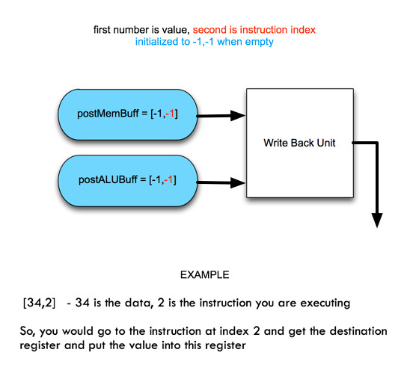
WB – Write Back Unit

Slide 39
Write-Back Unit
In a nutshell, the write back unit looks at the post-MEM and post-ALU buffers every cycle and if there is something there it writes it back to the appropriate register.
Write Back Unit: (From Instructions)
The WB unit can execute two write-backs in one cycle. It fetches the contents of the post-ALU and post-MEM buffers and updates the register file if there is something in the buffer to write back.

Slide 40
Coding Strategy Code and Test
Create a Write Back class and code it.
Create a driver for the class that keeps loading stuff into the two buffers and test the poo out of the class.
Do not move forward until you are absolutely certain the write back works with all data and register numbers, resets buffers empty when the stuff is removed, and will do the above with all combinations of data and reg numbers
Even better, write the test driver before you write the class!

Slide 42
ALU Unit
Input data structure:
Pre – ALU Buffer
preALUBuff = [-1,-1]
first number is instruction index, second is instruction index
preALUBuff can hold two instruction indexes per project spec!
You process the first one, then move the second to the first position if there is a second instruction and reset the second to -1. Can only process one instruction per cycle.
Output data structure:
Post – ALU Buffer:
postALUBuff = [-1,-1]
first number is value, second is instruction index

Slide 43
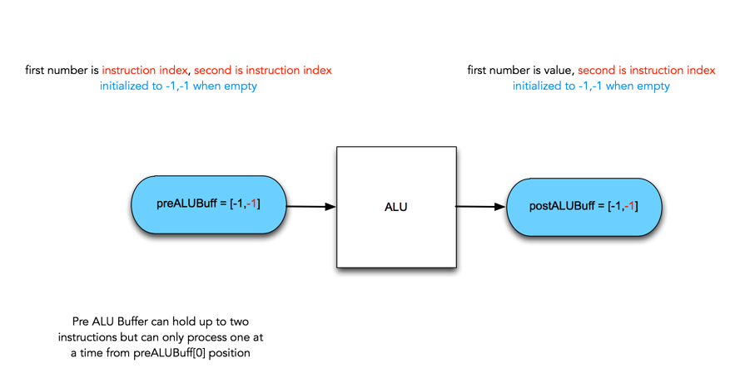
ALU set up

Slide 44
ALU Unit
Uses lists from disassembler for arguments. Expects values or -1’s in pre-alu buffer
Gets instruction and decodes which ALU instruction to execute. Executes instruction and updates alu post buffer with instruction index and the result of the ALU instruction
example of decoding and buff interaction:
# execute the instruction and put result into post buf [ result, instruction index] if self.opcodeStr[i] == "ADD": # ADD self.postALUBuff = [self.R[self.arg1[i]] + self.R[self.arg2[i]], i]
Move second index to position 0 and reset position 1 to -1. So you consume buff[0] first, move buff[1] to buff[0], and free up buff[1] . Then the next stage can put something in buff[1] buff[index0, index1] ; process index0; move index1 up, make second position -1

Slide 46
Mem Unit – Similar to ALU
Input data structure:
Pre – Mem Buffer
preMemBuff = [-1,-1]
first number is index, second is index
preMemBuff can hold two instructions per spec
Output data structure:
Post – Mem Buffer:
postMemBuff = [-1,-1]
first number is value, second is instr index

Slide 47
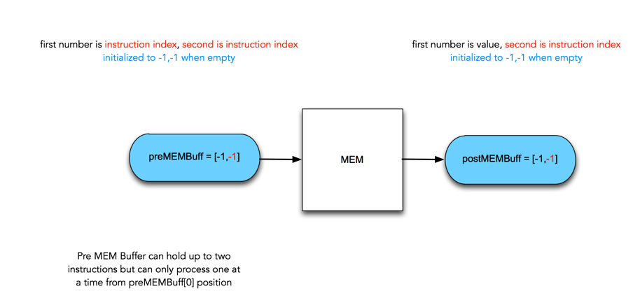
MEM set up

Slide 48
Mem Unit
Decodes instruction – is it STUR or LDUR?
Will be one of the two
Check cache for address.
If miss, Cache controller will return with miss on first cycle and will handle the memory access and cache load on that cycle and should return a hit on NEXT cycle.
If hit, either write cache for a store or write value obtained from cache to the postmembuff. All the mem unit is doing is either storing or loading mem values along with checking cache.
Update the premembuff[0] to premembuff[1] and set premembuff[1] to -1.

Slide 49
STUR
A STUR takes one cycle to finish if there is room in the cache set. If it cannot write in the cache set, then the operation cannot be performed and must be retried in the next cycle. In this case, the operation remains in the pre-mem buffer. When a cache write occurs, the STUR instruction just finshes. The STUR instruction never goes into the post-MEM buffer. It just disappears. Everything gets updated in the same cycle that the write happens.
If the required set is full then you must figure out what to kick out on that cycle and write the cache the next cycle. This may cause a stall since you are checking to see that all instructions in flight that might access the memory location have to wait. A RAW hazard.

Slide 50
LDUR
For LDUR, it takes one cycle to finish if it hits in the cache. If it misses in the cache, then the operation cannot be performed and must be retried in the next cycle. In this case, the operation remains in the pre-mem buffer while the needed element in memory gets moved to cache.
When a cache hit occurs, the operation finishes and the instruction and data will be written to the post-MEM buffer.

Slide 51
STOP HERE

Slide 53
Issue Unit
Input data structure
Pre Issue Buffer
<type 'list'>: [-1, -1, -1, -1] – List of four instruction indexes
Output data structure
Pre – Mem Buffer
preMemBuff = [-1,-1]
first number is index, second is index
preMemBuff can hold two instructions per spec
Pre – ALU Buffer
preALUBuff = [-1,-1]
first number is index, second is index
preALUBuff can hold two instructions per spec

Slide 54
Issue Unit
pre issue buff exists and has at least one instruction from fetch unit
The unit processes preIssueBuff entries in order 0…3 looking for hazards and if none found issue up to two instructions into appropriate preALU or preMEM buffer.
Ordering of LDUR and STUR instructions is enforced so that all stores get done prior to adjacent loads.
Every issue reorders the buffer upward and allows queue to take on more instructions to keep full
The pre issue buffer can be left with both unprocessed instructions and instructions that were delayed for hazards. An instruction can remain in the buffer for several cycles.

Slide 55
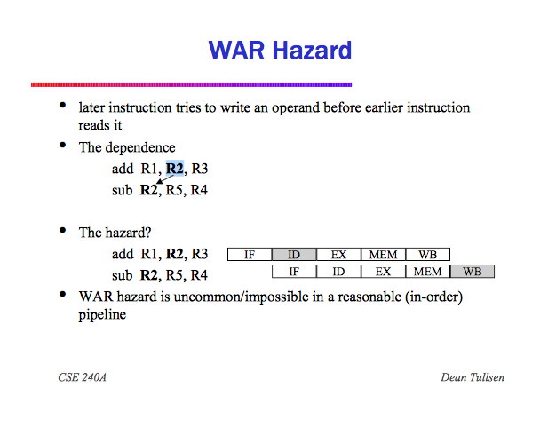
A WAR hazard

Slide 56
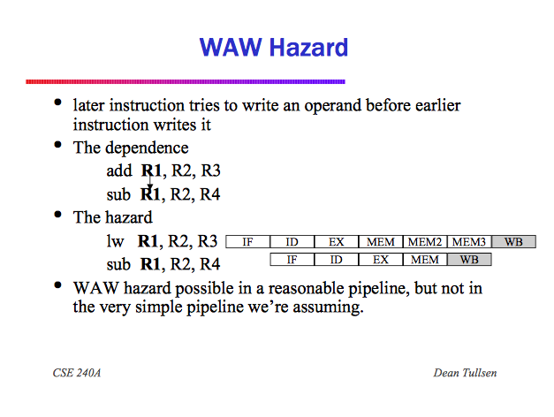
A WAW Hazard

Slide 57
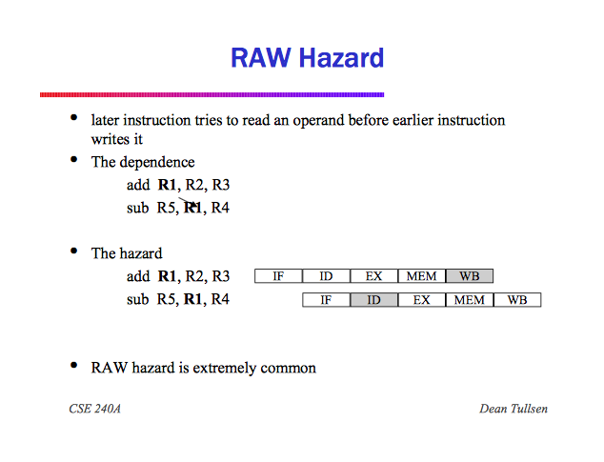
The RAW Hazard

Slide 58
Issue Unit Code
Class Issue:
def: run
1. Determine what's in the preIssueBuff at start of the cycle to get initial value ( numInIssueAtClockCycleBegin)
2. Process instructions in preIssueBuff in 0 .. 3 order. Look for hazards of all types between mostly adjacent instructions.
while( numIssued < 2 and numInPreIssueBuff > 0 and curr < 4 ):
curr is current pre issue element – means you are somewhere in the queue
2.1 Start with curr = preBuff [0]
2.2 Check for room in the preMemBuff and preALUBuff
if SetUp.isMemOp( index ) and not -1 in SetUp.preMemBuff: - example of checking
..... ..... .....
2.3 Do RAW hazard check

Slide 59
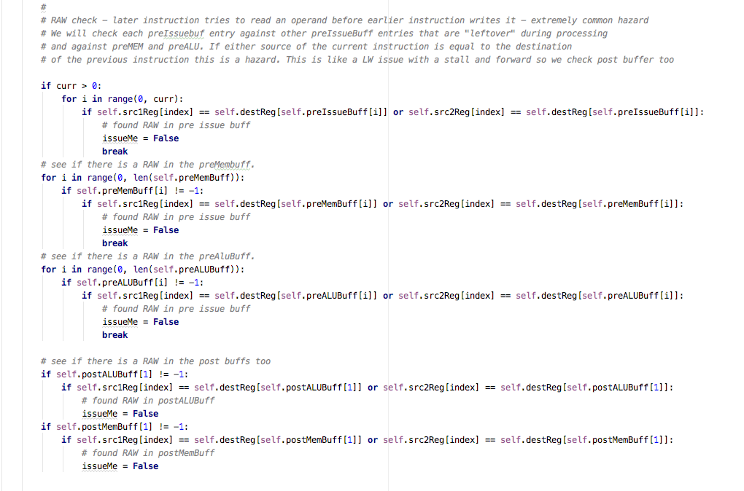
Issue Unit Code – RAW Checking

Slide 60
Issue Unit Code
2.4 Do RAW Check same as above plus check post buffs also
RAW check –
later instruction tries to read an operand before earlier instruction writes it - extremely common hazard
We will check each preIssuebuf entry against other preIssueBuff entries that are "leftover" during processing and against preMEM and preALU. If either source of the current instruction is equal to the destination of the previous instruction this is a hazard. This is like a LDUR issue with a stall and forward so we check post buffer too

Slide 61
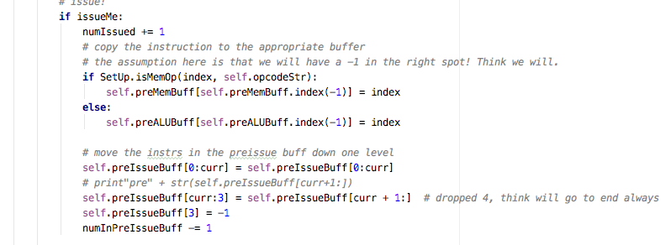
Issue Unit Code fix code example
2.5 Enforce ordering of LW and SW
# Enforce ordering of LWs and SWs so we make sure all stores get done # before loads
2.6 Issue and move instructions down one level in the preIssueBuff
Pre-Issue Buffer:
The pre-issue buffer has 4 entries, each entry can store a single instruction. The instructions are sorted in their program order (entry 0 always contains the oldest instruction and entry 3 contains the newest).
2.8 Else increment curr and make another pass curr is which instruction you are looking at

Slide 63
Fetch Unit
Input data structure:
All of the lists from the dissasembler
Output data structure:
Pre Issue Buffer
<type 'list'>: [-1, -1, -1, -1] – List of four instruction indexes

Slide 64
Fetch Unit
We will fetch up to two empty slots in the preissue buffer. We get an instruction, check in cache for it
If hit we will determine if it is a branch or B instructions. If is a branch instruction will check for hazards and if none perform the branch instruction.
B done without checking. The branch will never get posted to the pre issue buffer.
Checks for break instruction and if found performs clean up making sure all instructions finish.
If the first instruction in block to be fetched is not in the cache, the second instruction in block cannot be fetched even if it is in the cache
When the maximum number of instructions fetched, the entire program will cycle and start execution over again.

Slide 65
Strategy
Strategy:
Add the lists I showed you to your dis code
Start with the WB unit and unit test it.

